Slide 1















Property Assessment Tool
Presented by Toji Jose

Slide 2

Primary Objective
The primary objective of this project is to design and develop a user-friendly, data-driven property assessment tool that leverages geospatial mapping technology to enable financial firms to accurately evaluate and manage property-related risk, optimize investment decisions, and enhance overall portfolio performance.

Slide 3
Streamline property valuation processes: Automate and standardize property assessments, reducing manual errors and increasing efficiency.
01.
Project vision and mission
Enhance risk management: Provide a comprehensive risk profile for each property, enabling financial firms to make informed decisions.
02.
A web-map based property assessment tool with a user-friendly interface.,
A comprehensive database of property information and market data.
Automated valuation models and risk assessment algorithms.
Customizable reporting and analytics dashboards.
Integration with existing financial firm systems and processes.
.
Improve investment decision-making: Offer data-driven insights to optimize property investment and portfolio management.
03.
Increase transparency and compliance: Ensure adherence to regulatory requirements and industry standards.
04.

Slide 4

1. Map-Based Property Search: Utilize mapping APIs (e.g., Google Maps, Leaflet) to enable users to search and select properties by location, radius, or boundary.
2. Property Data Integration: Integrate with public records, MLS listings, and other data sources to provide detailed property information (e.g., ownership, zoning, sales history).
3. Automated Valuation Models (AVMs): Develop machine learning-based AVMs that consider property characteristics, market trends, and location-based factors.
4. Risk Assessment: Incorporate natural hazard data (e.g., flood zones, earthquake areas), environmental factors, and crime statistics to provide a comprehensive risk profile.
5. Customizable Reporting: Offer interactive dashboards and reports that allow users to visualize property data, valuations, and risk assessments.
6. Integration with Financial Systems: Ensure seamless integration with existing financial firm systems and processes.
Key Features

Slide 5

Creation process
1. Front-end: Develop a user-friendly interface using HTML5, CSS3, JavaScript, and a mapping library (e.g., Leaflet, Mapbox).
2. Back-end: Design a robust API using Node.js, Python, or Ruby, integrating with databases (e.g., PostgreSQL, MongoDB) and data sources.
3. Data Integration: Utilize APIs, web scraping, or data partnerships to aggregate property data.
4. Machine Learning: Train and deploy AVMs using libraries like scikit-learn, TensorFlow, or PyTorch.

Slide 6





Property Map Search
Detailed Property Reports
Mind map
Exploring creativity
Property Search
Property Sales Comparison

Slide 7
State Name (Drop down button)-fetch the State names from the Database
District (Drop down button)-fetch the District names from the Database
Property Search Window
Address
Map Search
Aadhaar ID
Property ID
Advance Search
Address Search Window
Type Address here (Options will be listed in drop down )
House No/House Name
Street
City
Postal Code
Property ID/TP No
Search
Clear

Slide 8
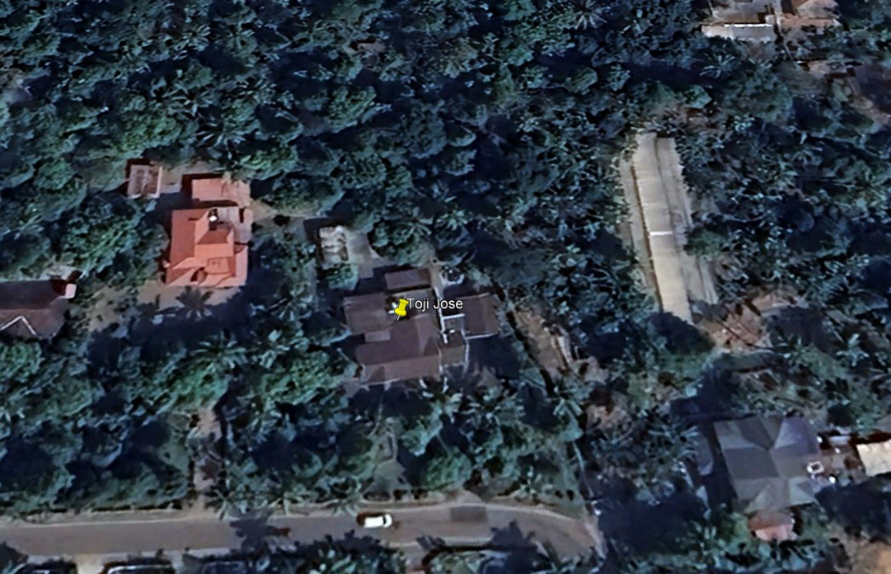
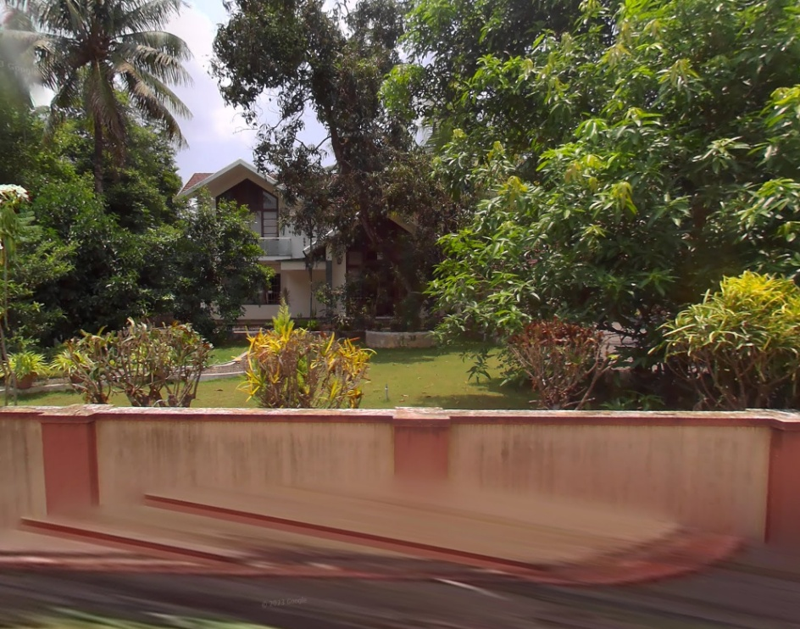
Property Report Window( When you select the address on address search,this window will pop up)
Save CSV/PDF
Print
Map/Image/Location
Google Street view/Photos
Property Info
Ownership Details( Owner Name ,Address,Sreet,House name ,Etc)
Land Details (Size,Type,Acres etc)
Building details (Type,No of Rooms etc)
Tax and Assessment
Tax year
Tax amount
Tax assessed value

Slide 9
Sales History
Owner Name
Year of Sales
Amount
Mortgage History
Date
Original Amount
Loan Type
Lender Name
Recently Sold Comparables
(Nearby sold properties that are similar to this property)
Address
Distance
Type of Property
Area (Sq ft)
Sales Date
Total Price
Price /Sq ft

Slide 10
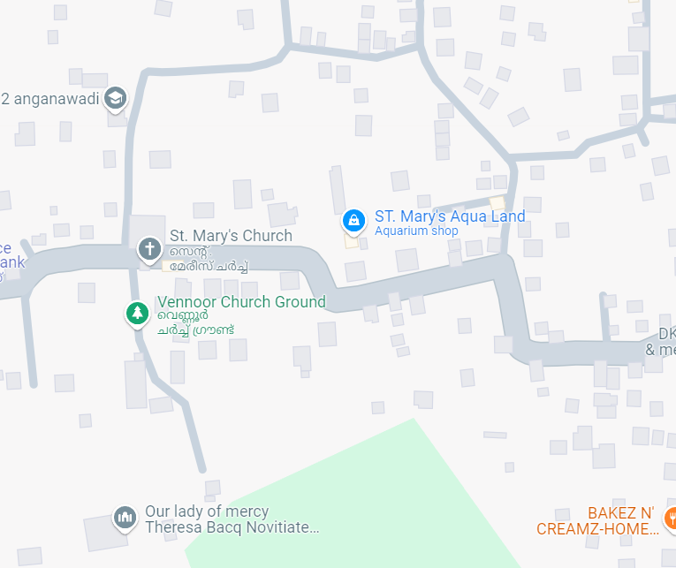
State Name (Drop down button)-fetch the State names from the Database
District (Drop down button)-fetch the Disstrict names from the Database
Map Search Window
Map Address Search Window
Street
Property ID/TP No
Type Address here
Creating a Shape
Freehand Polygon
City
Postal Code
Price Range
From
To
Area
From
To
Map Layers
Satellite
Parcels
Recent Sales
From
To
Search
Clear
Search
Clear

Slide 11
Search Criteria (Filter)
Save
Print
Results window
Automated Valuation Models (AVM)
Owner Name
Address
Property Type
Owner Name
Address
Property Type
Market Value Estimate
Owner Name
Address
Property Type
Owner Name
Address
Property Type
%
Property Report
Property Report
Property Report
Owner Name
Address
Property Type
Owner Name
Address
Property Type
Owner Name
Address
Property Type
Rent Value Estimate
Owner Name
Address
Property Type
Property Report
Property Report
Property Report
Owner Name
Address
Property Type
Owner Name
Address
Property Type
Owner Name
Address
Property Type
Property Report
Property Report
Property Report

Slide 12
Advance Search
Street
City
Search
Owner Name
Postal Code
Classification
Occupancy
Year of Built
Acres
Clear
Advance Search Result
Photo
country
state
City
Street
Postal Code
Photo
country
state
City
Street
Postal Code
Photo
country
state
City
Street
Postal Code
Photo
country
state
City
Street
Postal Code
Photo
country
state
City
Street
Postal Code

Slide 13
Sales Search
Sales Date
From
To
Sales Price
From
To
Street
City
Postal Code
Property Size (acres)
From
To
Year of Sale
From
To
Search
Clear

